Slide 1
Bitcoin
Source of most materials:
Xiwei Xu, Ingo Weber, and Mark Staples. Architecture for Blockchain Applications. Springer, 2019

Slide 2
What will you learn today?
Cryptography basics
Bitcoin

Slide 3
Cryptography basics

Slide 4
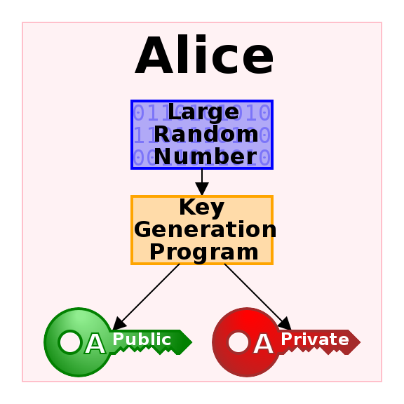
Public-key cryptography (1)
Overview
Public-key cryptography, or asymmetric cryptography, is a cryptographic system that uses pairs of keys:
public keys which may be disseminated widely;
private keys which are known only to the owner.
Effective security only requires keeping the private key private
Easy to create new key pairs
Used heavily in blockchain
Losing your private key can mean loss of assets
If hackers can get your private key, they can steal your assets
Some content from https://en.wikipedia.org/wiki/Public-key_cryptography

Slide 5
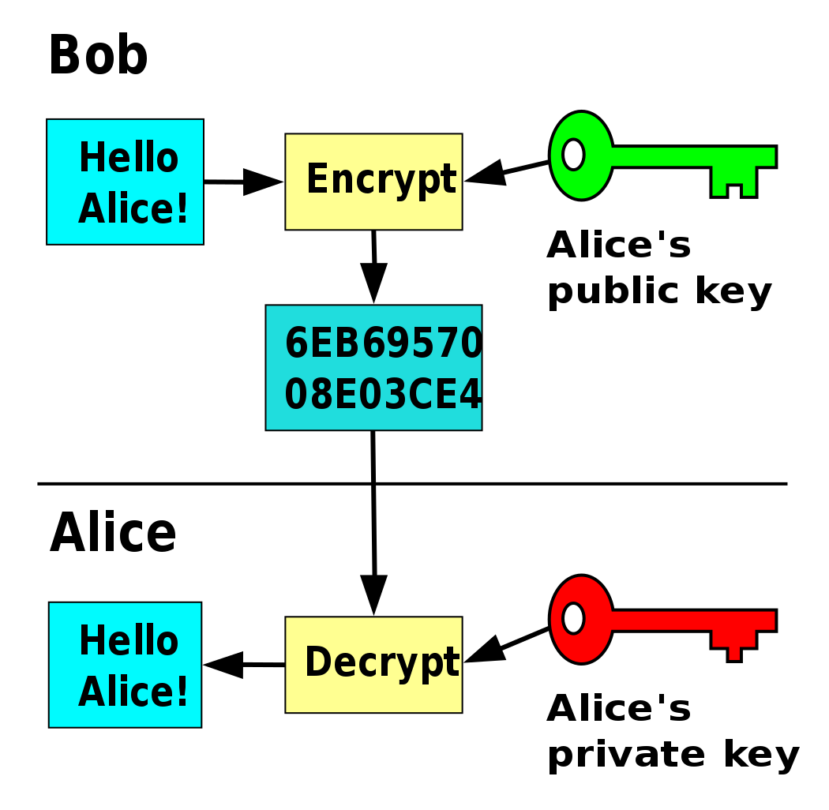
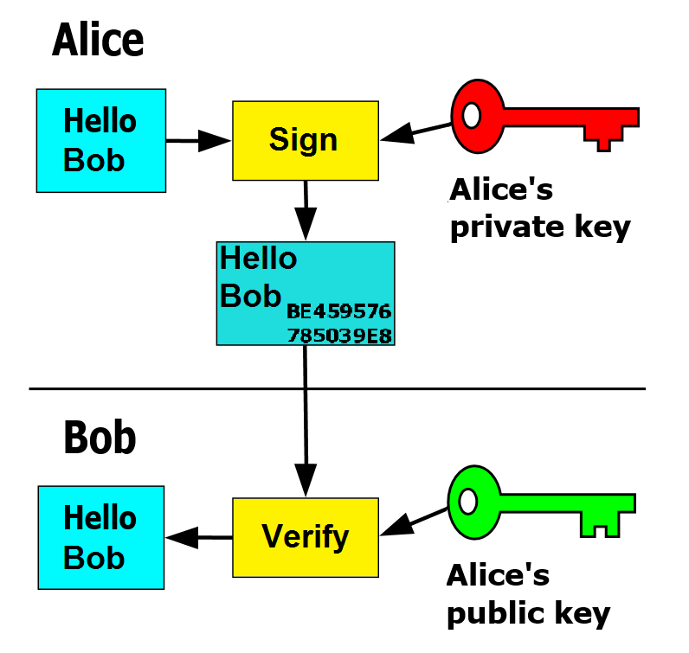
Public-key cryptography (2)
Encryption and digital signatures
Only Alice can decrypt the message
No-one can change the message without breaking
Alice‘s signature
Some content from https://en.wikipedia.org/wiki/Public-key_cryptography

Slide 6
Public-key cryptography (3)
Use in Blockchain
Control over accounts: by private key
Control means the ability to act on behalf of the account, like spending the assets it owns
In fact: each account is known by its public key
“Alice” here is really 0x7a2f16dab8b5c2cf99c35e4c6a5beb45c7df8f87
For some accounts, we may know the owner
But by default, we don‘t → Pseudonymity
Some content from https://en.wikipedia.org/wiki/Public-key_cryptography

Slide 7
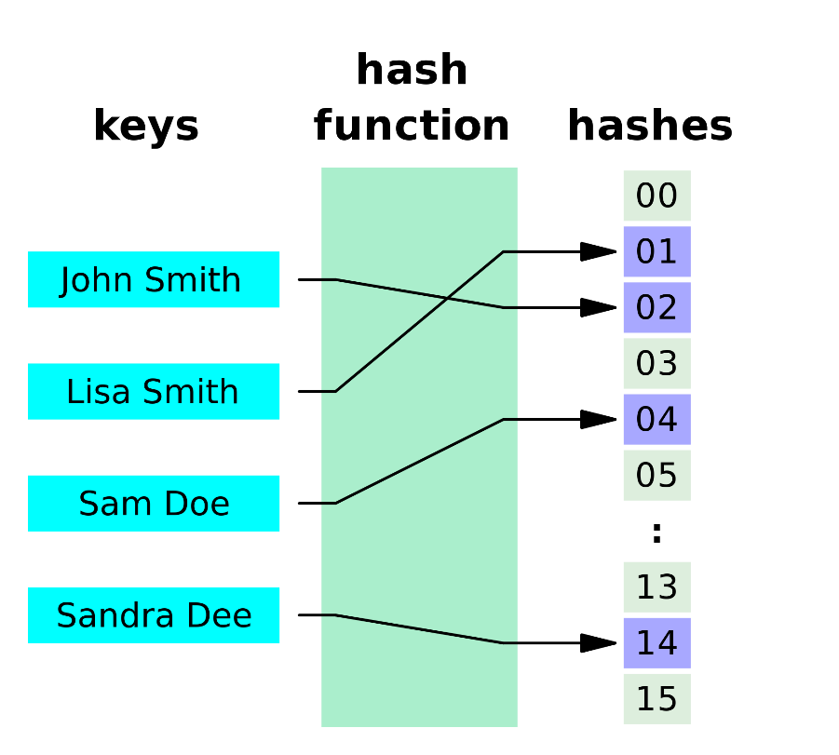
Hash functions (1)
A hash function is any function that can be used to map data of arbitrary size to data of a fixed size.
Values returned by a hash function are called hash values, hash codes, digests, or simply hashes.
Some content from https://en.wikipedia.org/wiki/Hash_function and https://en.wikipedia.org/wiki/Cryptographic_hash_function

Slide 8
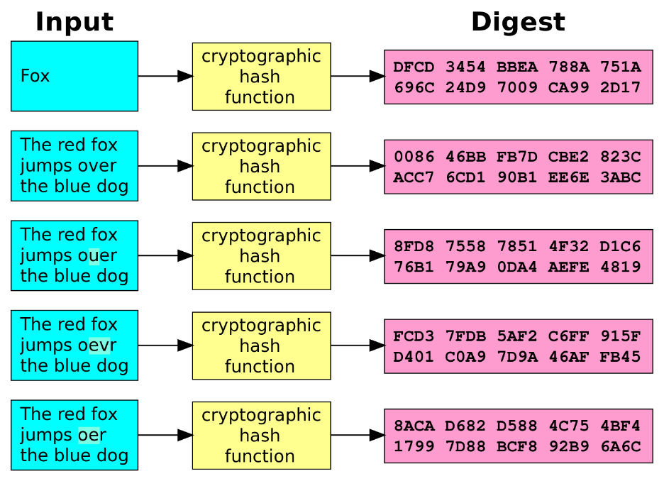
Hash functions (2)
A cryptographic hash function is a special class of hash function with certain properties:
a one-way function: a function which is infeasible to invert.
deterministic: the same message always results in the same hash
quick to compute hash value for any message
it is infeasible to generate a message from its hash value except by trying all possible messages
a small change to a message should change the hash value so extensively that the new hash value appears uncorrelated with the old hash value
it is infeasible to find two different messages with the same hash value
Input Hash value
Some content from https://en.wikipedia.org/wiki/Hash_function and https://en.wikipedia.org/wiki/Cryptographic_hash_function

Slide 9



Student Task
Take 1 minute to think about applications of hashes or public key cryptography that you know of
Take notes
Then we’ll discuss these

Slide 10
Bitcoin

Slide 11
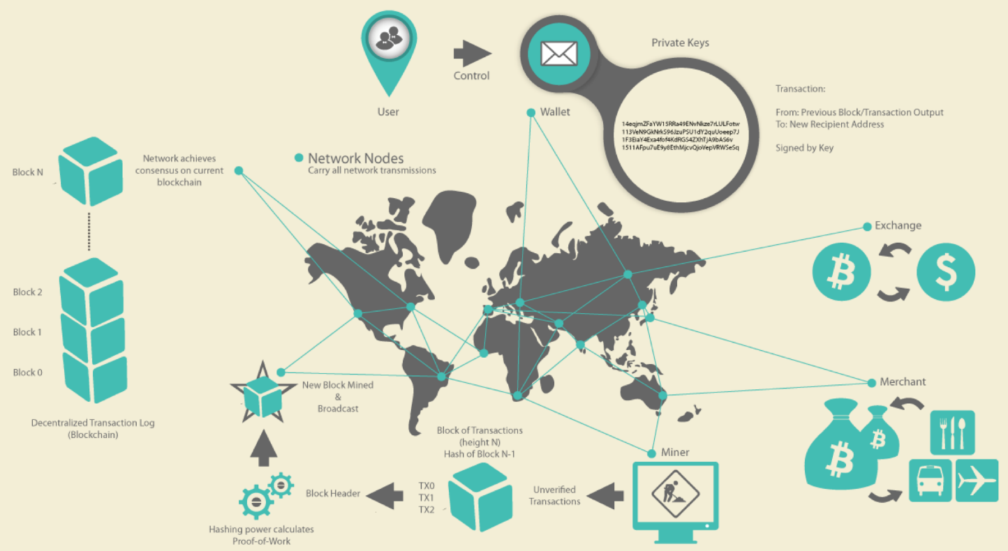
Bitcoin
First Cryptocurrency
Inventor: Satoshi Nakamoto (American? European? Denis Wright? Hal Finney?)
A cryptocurrency operated on a p2p blockchain network
3 main types of participants
Users with wallets which contain keys to authenticate the transaction sent by the user using digital signature
Miners for producing blocks which store the validated transactions
Exchanges where users can trade bitcoin with other currencies
Source: Andreas M.Antonopoulos, Mastering Bitcoin-Unlocking Digital Cryptocurrencies
Notes:
Someone named Satoshi Nakamoto is the founder of bitcoin.
However, we are not sure about the true identity of this person.
Evidence showed that he is either American or European, because his English writing is fluent in his blogs and articles.
Also, the time zone in which his articles were posted showed the same.
Some people claimed to the inventor, such as Denis Steven Wright.
He is a computer scientist and businessman from Australia.
As proof, he submitted details about the first-ever bitcoin transaction that happened between Hal Finney (the first person to ever receive bitcoins) and Satoshi.
But the claim is disputed by users within the bitcoin community.
Some people believe he was somehow involved the first transaction.
Some people guess that Hal Finney is indeed Satoshi Nakamoto, since they both lived in the same town.
But Hal Finney refuted the claim.
Generally speaking, Bitcoin is a cryptocurrency on a trust-less P2P network.
Bitcoin is regarded as the first generation of blockchain. And the first killer application.
Unlike traditional banking and payment systems, bitcoin is based on decentralized trust.
Bitcoin system doesn’t have a central trusted authority.
Trust is achieved as an property from the interactions of different participants in the system.
As overview diagram shown, the bitcoin system consists of three types of node.
The first type is the users with wallets which contain keys. The keys are used to authenticate the transactions sent by the user using digital signatures.
The second type of node is miners. The miners produce blocks which record the validated transactions.
The third type is exchanges. That is the places where users can trade bitcoin with other currencies.

Slide 12
Bitcoin
Walkthrough (recap from Lecture 1)
Users:
create transactions,
sign them, and
announce them to network
Miners:
receive transactions
include them in a new block,
(try to) append the new block to the data structure
When a transaction is part of the data structure, it has taken place (though it‘s a bit more complicated – more later).
Send 2 BTC from my account to Bob.
Signed: Alice

Slide 13
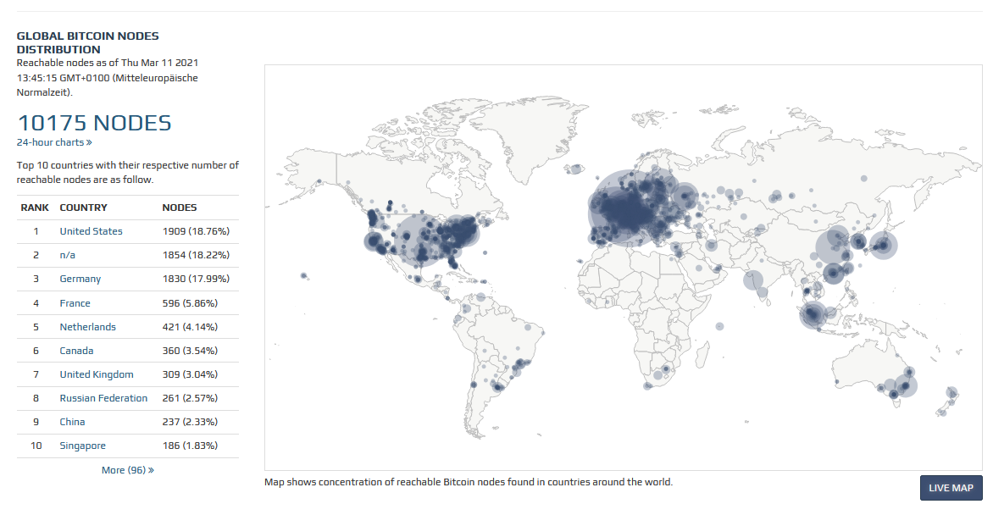
Bitcoin
Network Distribution
Source: bitnodes.21.co/
Notes:
This figure shows the global bitcoin nodes distribution.
We can see mostly in US, Europe, and China.
The data was collected on 22nd Nov 2018.
On the left side it shows the top 10 countries and the respective number of nodes.
There were 10,168 nodes in total.
US is ranked first. Germany 2nd, France 3rd, china 4th.
n.A. means the website is able to identify the country.

Slide 14
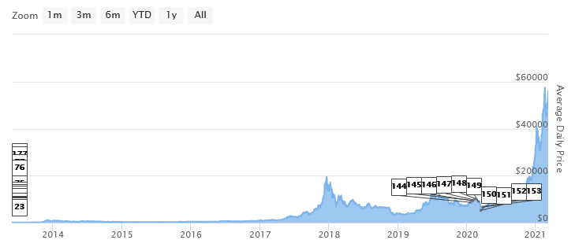
Bitcoin
Exchange rate to US$
Lowest: $0.05
Highest: ~$57,000
Now: ~$56,000
Not stable
Source: 99bitcoins.com/price-chart-history/
Notes:
1m
This figures shows bitcoin historical price.
The lowest price was 0.05 dollar.
The highest price was around 20,000 dollars, which was happened end of last year.
Bitcoin price has dropped below $US 5000 last week for the first time in 13 months.
The price has lost over 70% since January.
Because its price changes massively and frequently since it was invented.
Some people think it is an asset but not a currency.
Because it is not stable enough to be used as real money.

Slide 15
Bitcoin
Deflationary Cryptocurrency
Total supply: 21 million
New BTCs are issued during the mining process
New BTCs are rewarded to the miner who create the valid block.
The reward is halving every 210,000 blocks.
Reward (since 2016): 6.25 BTC (initially, 50 BTC)
Minting in Bitcoin will run out in 2140, when no more new BTC being issued.
Notes:
1m30s
Blockchains is the cryptocurrency on bitcoin blockchain..
Bitcoin provides a deflationary cryptocurrency by defining certain rules.
The total amount of BTC that will be released over the lifecycle of Bitcoin is 21 million.
New BTCs are issued during the mining process.
Each time a new block is mined and successfully added into the blockchain, new BTCs are rewarded to the miner who create the valid block.
The rewards is halving every 210,000 blocks.
Initially, the reward is set to 50 BTC, and fell to 25 BTC in late 2012.
Minting in Bitcoin will run out in 2140, when no more new BTC being issued (unless the rules change).

Slide 16
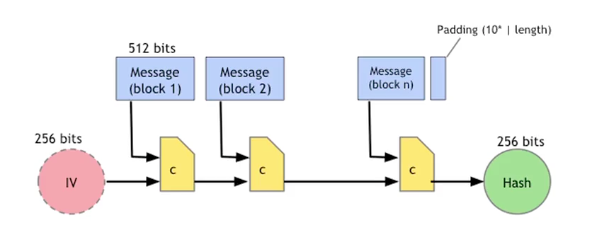
Bitcoin
SHA-256 Hash Function
Hash function
Map data of arbitrary size to data of fixed size
One-way function –easy to compute but hard to invert –collision free
Notes:
4m
==
44m10s
A hash function is any function that can be used to map data of arbitrary size to data of fixed size.
It is collision free.
Hash functions are one-way functions which are easy to compute, but hard to invert.
Means you can not have the same output data if you run different input data through the hash function.
If even one bit of the input data changes, its corresponding hash value would change radically.
There are lots of hash functions. The one bitcoin uses is SHA-256.
Basically, it takes the message that you're hashing, and it breaks it up into blocks that are 512 bits in size.
The message isn't necessarily exactly a multiple of the block size because it will add some padding at the end.
The padding consists of a one bit, followed by some number of zero bits.
This padding will put at the end of the block.
So once you've padded the message so that its length is exactly a multiple of the 512 bit block size.
You then chop it up into blocks, and you then execute this computation.
You start with the 256 bits value called the IV(initial vector). That's just a number that you look up in a standards document. And then take the IV and the first message block.
You take those 768 total bits, and you run them through this special compression function, c, and outcomes a message of 256 bits in size.
You now take that with the next 512 bits of the message, run it through c again, and you keep going.
When you get to the very end, you have consumed all of the blocks of the message plus the padding.
The result is the hash, that's a 256 bit value.
And it's easy to show that, if this compression function is collision free, then this entire hash function will also be collision free.

Slide 17

Bitcoin
Linked list with hash pointer
Time between blocks, called inter-block time, is on average 10 minutes → But variation of times is high
Genesis Block
H( )
of previous block
of previous block
of previous block
H( )
H( )
H( )
Transactions
⁞
Transactions
⁞
Transactions
⁞
Notes:
1m30
Blockchain in general is like a linked list with hash pointer.
There are a series of blocks and each block has a list of transactions containing data.
In the block header, it has a hash value, which is the hash value of the entire previous block.
Blockchain has tamper evident property.
If someone wants to tamper with the data in the middle of the chain.
So someone changed the contents of this block. And therefore, the hash here which is a hash of this entire block is not going to match up.
And so we could detect the inconsistency between this data and the hash pointer that we remembered before.
If someone wants to tamper with data in this entire chain, in order to keep the story consistent he's going to change all the way to the end.

Slide 18
Bitcoin
Block – Container of Transactions
Merkle Tree: Binary tree built using the hash function
H( )
H( )
H( )
H( )
H( )
H( )
H( )
H( )
H( )
H( )
H( )
H( )
H( )
H( )
Tx₁
Tx₂
Tx₃
Tx₄
Tx₅
Tx₆
Tx₇
Tx₈
Notes:
2m
Now, let’s look at the data structure within a block.
A block is a container of transactions.
The data structure within a block is a binary tree built using the hash function.
The binary tree is called Merkel tree in Bitcoin since it is invented by Ralph Merkle.
The idea is:
Suppose we have a bunch of data blocks which are transactions.
They can be represented as the leaf node in the tree.
For each pair of transaction, we will generate a hash value of each transaction and combine the two hash value as the value of the node at the upper level.
We'll then go another level up and this node here will contain a value that combines the hash value of these two children down here.
And so on, all the way back up to the root of the tree.
And then we just need to remember the hash at the root of the tree.
If someone tampers with some data block down here at the bottom. It will not match the hash value of the parent. So he'll have to tamper with that.
So he'll have to tamper the hash value all the way to the root. We just need to remember the root hash to detect the tampering.

Slide 19
Bitcoin
Transactions
Transfer currency from source addresses to destination addresses
Each transaction contains one or more inputs and one or more outputs
If the sum of the outputs is less than the sum of the inputs, the difference is a fee to the miner
Transaction fee is an incentive for miners to contribute computing power
The only variable that client software ask users to choose when create a transaction
Contains proof of ownership for each input, in the form of a digital signature from the owner
2
How transactions are linked

Slide 20
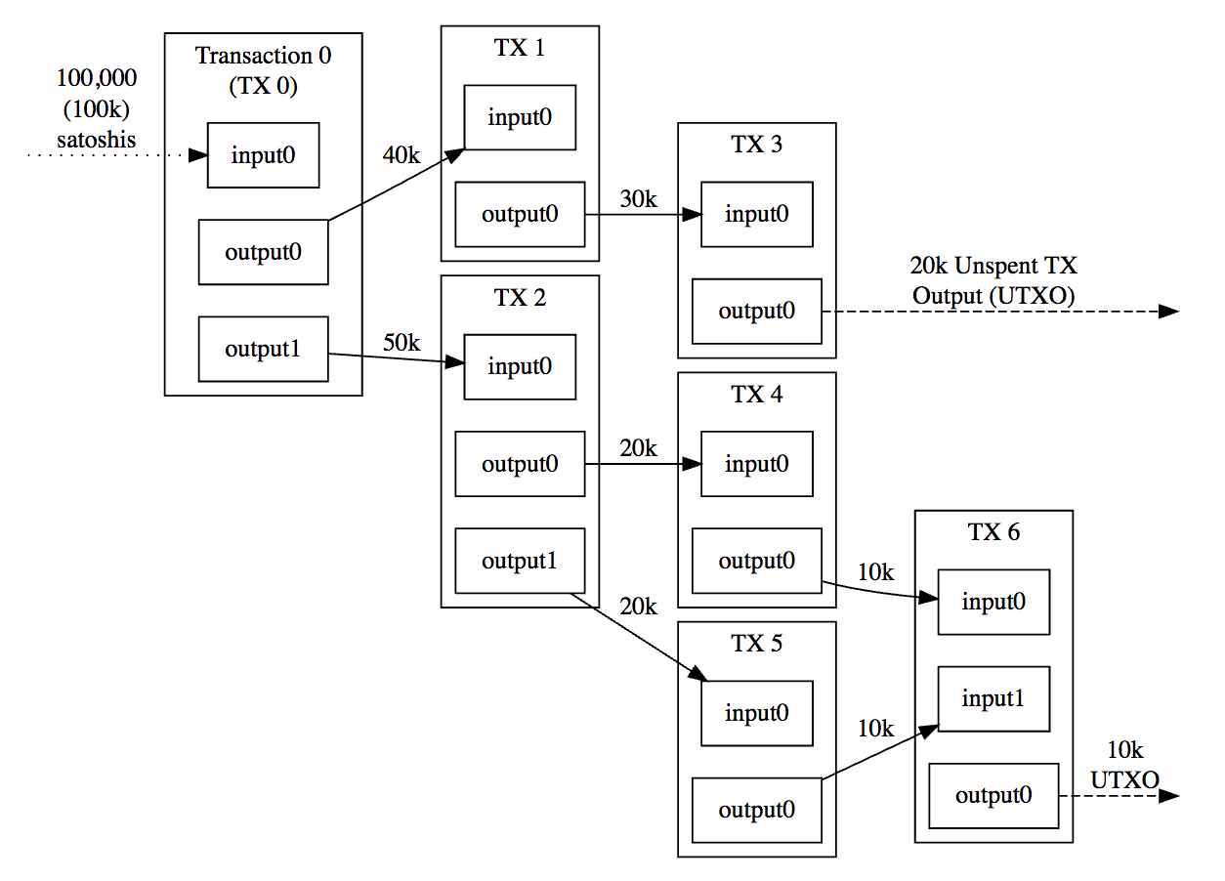
Bitcoin
Transactions
Linked Transactions
Outputs of transactions become inputs of new transactions
Bitcoin addresses don’t contain “coins”
Store unspent transaction outputs (UTXO)
Each transaction output can be spent exactly once!
“Address balance”: the sum of all of the values of UTXOs associated with the address
Bit“coin” is misleading, because fractional ownership (e.g., 1.64 BTC) is the norm
Notes:
1m
Transactions are also chained together.
The outputs of transaction become the inputs of new transactions. Here, in this figure, output0 in TX0 becomes input0 in TX1.
Bitcoin doesn’t have an address “containing coins,”
“coins” are actually stored as “unspent transaction outputs” or UTXOs for short.
A UTXO can be associated with a bitcoin address, and you can also have many different UTXOs that are associated with the same bitcoin address.
The “address balance” is the sum of all of the values of UTXOs associated with the address.

Slide 21
Student Task
Take 2 minutes to draw linked transactions that do the following:
You have two inputs, 1 BTC each
You want to send 1.6 BTC to your friend, and pay a fee of 0.01 BTC
Then we can discuss your results

Slide 22
Student Task: solution
Take 2 minutes to draw linked transactions that do the following:
You have two inputs, 1 BTC each
You want to send 1.6 BTC to your friend, and pay a fee of 0.01 BTC
Then we can discuss your results
TX
1 BTC
input0
1 BTC
input1
Implicitly, these inputs and outputs result in a fee of 0.01 BTC
output0
1.6 BTC (to your friend)
output1
0.39 BTC (to yourself)

Slide 23
Bitcoin
Transactions
Transactions delay factors
Transaction fee
Miners tend to optimize block creation by preferring transactions with higher fees
Transaction announcement happens during mining of next block
Mining will not be restarted, so new transactions can only be included in the block after the next one → theoretical inclusion delay is 1.5x inter-block time
Orphan
Transactions must arrive in order for a miner to process them fast
If the referenced input transactions, called parents, are as-yet unknown, a miner will delay the inclusion of the new transaction — it is then a so-called orphan
Miners may choose to keep orphans in the mempool while waiting for the parent transactions to arrive, but they also remove orphans after a time-out they choose
Locktimes
A transaction can contain a parameter declaring it invalid until the block with a certain sequence number has been mined
Notes:
There are some factors which cause transactions delay.
As we mentioned, there is a “transaction fee,” which is paid to the miner who creates the valid block containing this transaction.
It is an incentive for miners to contribute their computing power.
The transaction fee is often the only variable that client software asks Bitcoin users to choose when creating a new transaction.
So when minders create a block, they tend to include transactions with higher fees.
The second factor is orphans.
In blockchain, transactions must arrive in-order for a miner node and the blockchain network to be able to process them fast.
Incoming transactions are handled by the so-called mempool.
If the referenced input transactions, called parents, are not known yet, a miner will delay the inclusion of the new transaction.
Those transactions are called orphans.
Miners may choose to keep orphans in the mempool while waiting for the parent transactions to arrive, but they may also remove orphans after a time-out they choose.
Some experienced users will set locktimes: a transaction can contain a parameter declaring it invalid until the block with a certain sequence number has been mined.

Slide 24
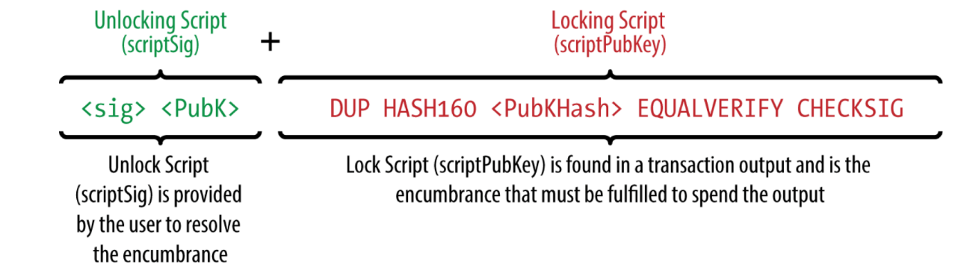
Bitcoin
Script
Bitcoin uses a scripting system for transactions
Transaction validation relies on two types of script
A locking script in an output specifies the conditions for spending the BTC
An unlocking script in an input satisfies the conditions of the locking script
The unlocking script and the locking script are combined and executed
If the result is true, the transaction is valid
Script keywords are called opcode
Pay-to-PubKey-Hash(P2PKH): the most common opcode implements a simple transfer
Notes:
2m
Bitcoin uses a scripting system for transactions.
The language is called script.
First, the script language is Turing incomplete.
It has limited complexity without looping and complex flow control.
A script is a list of instructions associated with each transaction. The execution of the script is stack based.
A locking script is placed on an output, which specifies the conditions that must be met to spend the BTC.
An unlocking script is placed in an input that satisfies the conditions of the locking script. most of the time they contain a digital signature of the money owner.
To validate a transaction, the unlocking script and the locking script are combined and executed. If the result is true, the transaction is valid.
The most common case implements a simple transfer, referred to as Pay-to-PubKey-Hash (P2PKH), where the locking script specifies which (hashed) public key and corresponding signature are required to unlock the output. In other words: only the holder of the designated key pair can spend the output.

Slide 25
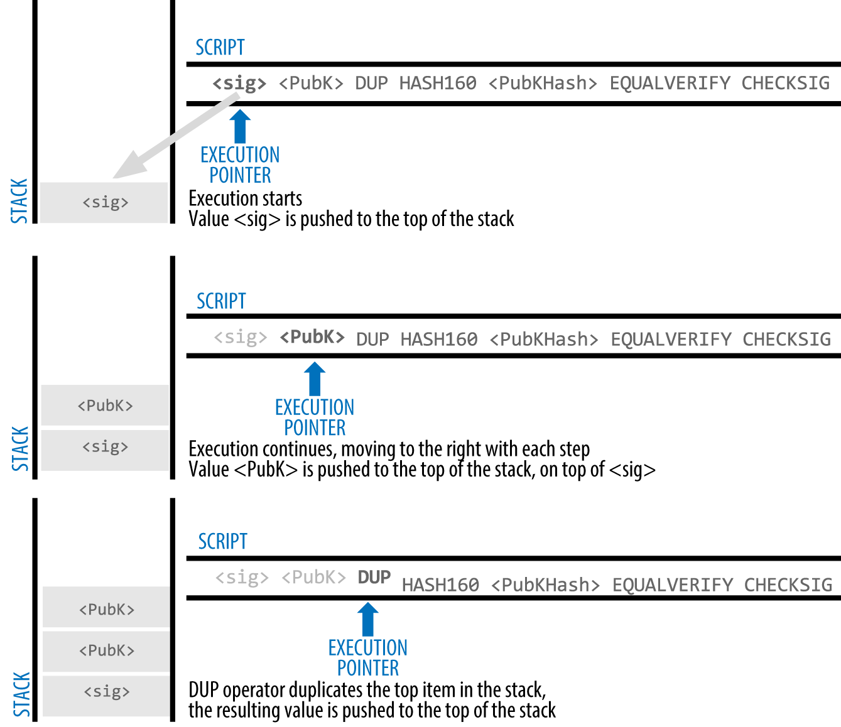
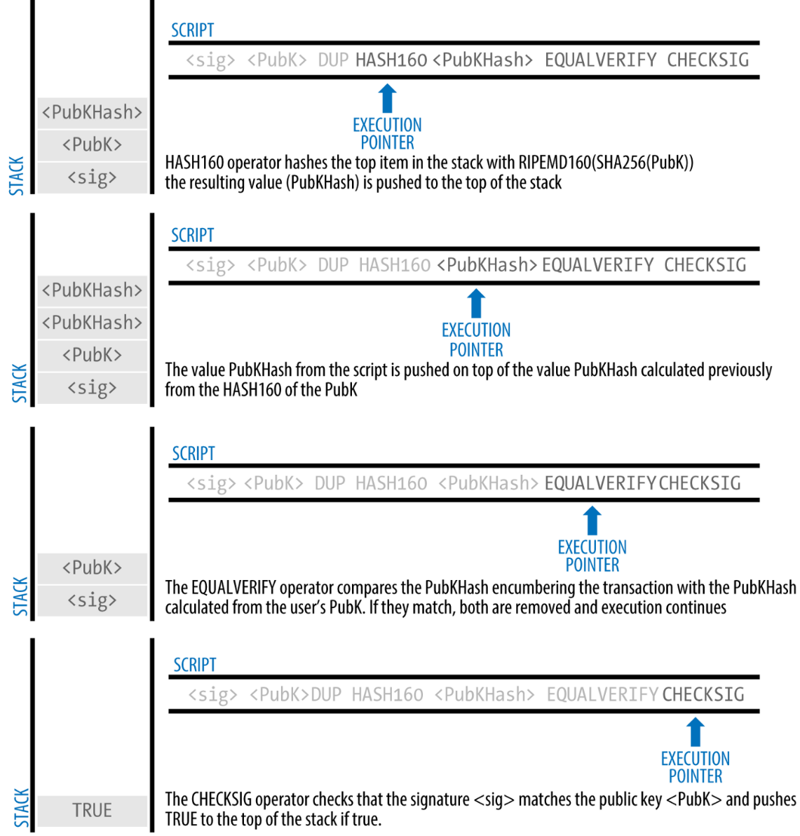
Bitcoin
Script – Stack-based Execution
Notes:
2m
Bitcoin uses a scripting system for transactions.
The language is called script.
First, the script language is Turing incomplete.
It has limited complexity without looping or complex flow control.
A script is a list of instructions associated with each transaction. The execution of the script is stack-based.
A locking script is placed on an output, which specifies the conditions that must be met to spend the BTC.
An unlocking script is placed in an input that satisfies the conditions of the locking script. Most of the time they contain a digital signature of the money owner.
To validate a transaction, the unlocking script and the locking script are combined and executed. If the result is true, the transaction is valid.
The most common case implements a simple transfer, referred to as Pay-to-PubKey-Hash (P2PKH), where the locking script specifies which (hashed) public key and corresponding signature are required to unlock the output. In other words: only the holder of the designated key pair can spend the output.

Slide 26
Bitcoin
Script
Provides certain flexibility to change the parameters of the conditions to spend the transferred BTC
Multi-signature: A transaction can require multiple keys and signatures
OP_RETURN
An opcode used to mark a transaction output as invalid
Has been used as a standard way to embed arbitrary data to the Bitcoin blockchain for various purposes, like representing assets, e.g. diamonds
Notes:
30s
Script provides flexibility to change the condition parameters to spend the transferred bitcoin.
For example, a transaction require multiple key and signatures.
OP_RETURN is a script keyword, called opcode.
It is used to mark a transaction output as invalid.
OP_RETURN has been used as a standard way to embed arbitrary data for other purpose like representing assets.

Slide 27
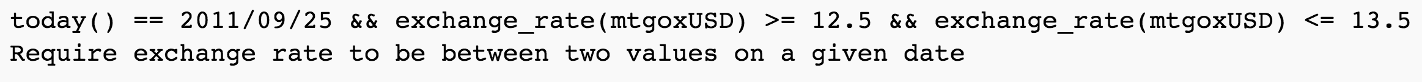


Bitcoin
Script
Script programs are pure functions, which cannot import any external state
An oracle can be used to include external state into the blockchain execution environment
Measurement request for user-defined expression
Money
Exchange
Signature if true, error if false
Oracle
Others
Notes:
By design, Script programs are pure functions.
They cannot poll external servers or import any external state.
We must rely on an oracle to make blockchain connect with the external world.
An oracle is a server that has a keypair.
When a bitcoin node requires an external state to validate a transaction, it send the hash of the user-defined expression to the Oracle.
Blockchain sends measurement request to oracle and oracle evaluates the transaction.
The Oracle signs transactions when the user-defined expression is true.

Slide 28
Bitcoin
Mining
Miners compete to create new blocks by solving hash puzzles
Bitcoin proof-of-work: hashcash
Receiving a new block
End of one round of a competition is the beginning of the next round
Aggregation
Remove the transactions of the newly announced block from transaction pool
Aggregate remaining valid transactions; select subset that can be included
Add coinbase transaction as the first transaction to the transaction list for the next block
Header Construction
Calculate the hash of the previous block
Construct a merkle tree to summarize all the included transactions
Solving puzzle
Find solution to the proof-of-work algorithm
The result will be inserted to the block header if successful
Propagation
If found, the new block is immediately propagated
Notes:
In bitcoin, the mining nodes compete in a proof-of-work system to create new blocks by solving hard cryptographic puzzles.
It uses the hashcash proof-of-work function.
Miners are always listening for new transactions and new blocks.
When a transaction reaches a mining node, it is verified, included into the mempool and propagated to the network.
When a miner received a new block, that means the end of one round of completion and an announcement of a winner.
It is also the beginning of the next round.
To start mining a new block, the miner first removes the transactions from the mempool that belong to the received block, and aggregates a set of the remaining valid transactions into a candidate block.
It also adds the so-called coinbase transaction as the first transaction to the list of transactions for the new block.
The coinbase transaction pays a block reward to the miner, which is another incentive for mining (in addition to the transaction fees).
Then the miner constructs the block header, which includes a hash of the previous block, and Merkle root.
Merkle root is the root of a Merkle tree.
And Merkle tree is a binary tree which is a summary of all the transactions for more efficient searching.
Then, its time to find a solution to the proof-of work algorithm.
After the block is successfully mined, the result will be inserted into the block header,
The node which finds the solution first gets the right to produce the new block.
The new block is immediately propagated to the network.
The nodes receiving the new block, verify the block before chaining it into the blockchain.

Slide 29
Bitcoin
Mining – Proof-of-Work
Solve a hash puzzle - finding a value for a field in the block header, the nonce, which leads to the block hash being smaller than a given threshold
Requires a lot trials and errors – try values until you get luck
The threshold is adjusted over time to ensure that the average inter-block time is 10 minutes
The likelihood to solve the puzzle is proportional to the compute power invested relative to all compute power in the network
Nonce
H( ) of previous block
H(nonce || H() of previous block || Tx || … || Tx) is very small
Transactions
⁞
Output space of hash (256 bits)
00000…
Target space
Existing Blockchain Platforms
Notes:
We just mentioned the miner needs to find a solution to a proof of work function in order to get the right for adding the new block.
The proof-of-work function requires finding a value for a free field in the block header, the nonce. So the value can lead to the block hash being smaller than a given threshold.
In short, finding such a nonce requires a lot of trial and errors
The threshold is adjusted over time to ensure that the average time between blocks is around 10 minutes.
In other words, the puzzle is so hard that all Bitcoin miners around the world together still take 10 minutes on average to solve it.
Creation of every new block requires solving a new puzzle.
The likelihood to solve the puzzle first is proportional to the compute power invested relative to all compute power in the network.

Slide 30
Bitcoin
Nakamoto Consensus
Miners might find and announce the next block at the same time
Treat the longest history of blocks as the main chain
The one that received most computation
Fork in the blockchain
Fork decided: longer chain wins
Notes:
1m
Most public blockchains use Nakamoto consensus, which was introduced with the Bitcoin blockchain.
In Nakamoto consensus, processing nodes by convention treat the longest history of blocks as the authoritative history — it is called the main chain.
Before one chain is longer than the other, it is unclear which state will prevail.
In combination with proof-of-work, the longest chain corresponds to the one that (on average) received most computation.
Mining the next block is a constant global race between ten thousands of computers in the Bitcoin network.
Multiple computers might more or less simultaneously find and announce the next block, say n+2 in the example above.
The decision which version of block n+2 becomes part of the main chain is made by the winning block n+3 and to which block n+2 it refers as predecessor.
However, there might be multiple conflicting versions of block n+3 referring to different predecessors n+2.
While possible, the Bitcoin protocol renders it very unlikely that such parallel forks continue for more than a block or two (unless the network is separated, which is unlikely for larger portions internet).
Due to this possibility, users want to determine with high probability that a transaction is permanently included in the blockchain.
Users therefore wait for several blocks to be mined after the first inclusion of their transaction to gain confidence that the block including their transaction is part of the main chain.
Each of these subsequent blocks is called a confirmation block, and when sufficiently many confirmations occurred after the transaction block inclusion, then the transaction is considered committed.
Depending on the importance of the transaction and the risk of it being excluded, the number of required confirmation blocks might need to be higher or lower. A default number is 6 blocks (1 for inclusion and 5 confirmation blocks), though the source of this number is somewhat arbitrary.
This equates to a probabilistic guarantee meeting a (usage-specific) likelihood threshold.

Slide 31
Bitcoin
Nakamoto Consensus
To determine with high probability that a transaction is permanently included:
Wait for several blocks (5 blocks by default) to be added after first inclusion of the transaction
Each of these subsequent blocks is called a confirmation block
Once sufficiently many confirmations occurred after the transaction block inclusion, then the transaction is considered committed
Unlike many traditional transaction commit semantics:
Commit only has a probabilistic guarantee
A longer chain could appear – although it may be very, very unlikely
Notes:
1m
Most public blockchains use Nakamoto consensus, which was introduced with the Bitcoin blockchain.
In Nakamoto consensus, processing nodes by convention treat the longest history of blocks as the authoritative history — it is called the main chain.
Before one chain is longer than the other, it is unclear which state will prevail.
In combination with proof-of-work, the longest chain corresponds to the one that (on average) received most computation.
Mining the next block is a constant global race between ten thousands of computers in the Bitcoin network.
Multiple computers might more or less simultaneously find and announce the next block, say n+2 in the example above.
The decision which version of block n+2 becomes part of the main chain is made by the winning block n+3 and to which block n+2 it refers as predecessor.
However, there might be multiple conflicting versions of block n+3 referring to different predecessors n+2.
While possible, the Bitcoin protocol renders it very unlikely that such parallel forks continue for more than a block or two (unless the network is separated, which is unlikely for larger portions internet).
Due to this possibility, users want to determine with high probability that a transaction is permanently included in the blockchain.
Users therefore wait for several blocks to be mined after the first inclusion of their transaction to gain confidence that the block including their transaction is part of the main chain.
Each of these subsequent blocks is called a confirmation block, and when sufficiently many confirmations occurred after the transaction block inclusion, then the transaction is considered committed.
Depending on the importance of the transaction and the risk of it being excluded, the number of required confirmation blocks might need to be higher or lower. A default number is 6 blocks (1 for inclusion and 5 confirmation blocks), though the source of this number is somewhat arbitrary.
This equates to a probabilistic guarantee meeting a (usage-specific) likelihood threshold.

Slide 32
Student Task
Nakamoto consensus results in probabilistic “commit”
Users choose how many confirmation blocks are needed to view a transaction as committed
In breakout groups, think about different use cases where higher and lower numbers of confirmation blocks might be needed
Take notes

Slide 33
Student Task
Question: what does more mining power mean?

Slide 34
Bitcoin
Accounts and States
An account is associated with a cryptographic key pair
Public key is used to create the account address
Private key: sign transactions sent from the account
The account balance is the sum of UTXO that an account has control over
The state of the blockchain, and the account balances of all users, result from the genesis block (very first block of the blockchain) and the set of transactions included since
Some accounts might be pre-loaded with an initial account balance from the beginning
As transactions are grouped into blocks, the entire system moves from one discrete state to another through adding a new block
Notes:
2m
===
66m30
An account in Bitcoin is associated with a cryptographic key pair.
The public key is used to create the account address, which is somewhat similar to the bank identifier and account number in traditional banking (or their combination as an International Bank Account Number, IBAN). BTC can be sent to an account address.
The corresponding private key is required to sign transactions sent from the account.
Because the source account is known, every node in the network can verify the signature.
This is achieved with the locking/unlocking scripts we discussed before.
The state of the blockchain, and specifically the account balances of all users, result from the set of transactions and the genesis block, which is the first block (block number 0).
Some accounts might be pre-loaded with an initial account balance from the beginning, i.e. in the genesis block.
When a transaction from A to B occurs, A’s balance is reduced by that amount and B’s account is increased by that amount. The miner C may also receive a transaction fee, if A specified that, in which case B receives less than A sends. The transaction becomes part of the ledger when the miner creates a block that includes it and when that block is included by consensus in the blockchain data structure. Then the transfer has occurred. The miner C is paid a block reward for this new block through the coinbase transaction mentioned above.
Bitcoin does not track account balances explicitly.
The Bitcoin blockchain platform has exactly two first-class elements: transactions and blocks.
The account balance is therefore derived as the sum of unspent transaction outputs (abbreviated to UTXO) that an account has control over.
Bitcoin’s record keeping model is therefore referred to as UTXO, in contrast to Ethereum’s account/balance model.
Either way, every node has access to the full transaction history, and thereby knows which account holds how much currency.
Because accounts are pseudonymous, typically the persons holding each account are not known to most actors.
As transactions are grouped into blocks, the entire system moves from one discrete state to another through adding a new block containing many transactions.

Slide 35
Bitcoin
Wallets and Exchanges
Wallets
Software wallet: Manage a collection of private keys corresponding to their accounts, and to create and sign transactions
Hardware wallets are devices that store private keys in chips
Cold storage backups: to avoid key loss/stores a representation of the keys independent of the user’s current hardware wallets
Exchanges
Places to trade Bitcoin with other currencies
Holds currency on behalf of users
Clients may choose to ask the exchange to transfer purchased Bitcoin to an address under their control
If the exchange’s system fails, their users may lose control of “their” Bitcoin.
Key stakeholders for public blockchain
Provide liquidity for cryptocurrency, which supports its real-world value
Underpin the incentive mechanism
Notes:
A software wallet allows users to manage a collection of private keys corresponding to their accounts, and to create and sign transactions on the Bitcoin network.
A wallet may include a full node, but does not have to.
SPV (Simplified Payment Verification) nodes maintain only part of the blockchain and verify if and when particular transactions are included in a block without downloading the entire blockchain ledger.
That allows running wallets on resource-constrained devices, such as smartphones.
Hardware wallets are specialized devices that provide part of the above functionality, typically in combination with suitable software.
A common split is to create and store private keys on the hardware; they never leave the device.
Public keys are exported, so that payments can be received.
For outgoing payments, the unsigned transaction is sent from the software to the device, verified by the user on the display of the device and confirmed with a PIN, and then signed by the device and sent back to the software wallet.
To avoid accidental loss of private keys, and thereby loss of the ability to spend one’s funds, there are cold storage solutions as backups.
These work by storing a representation of the keys in a way that is independent of the user’s current hardware wallets and machines.
The simplest way is to write key pairs down on paper.
More user-friendly methods work by writing (or printing) 12 or 24 words out of a dictionary on paper.
All cold-storage solutions of course need to be protected from conventional threats.
An interesting alternative to paper are custom metal plates in which the keys are set and physically locked in place — these have the advantage of being fire-proof.

Slide 36
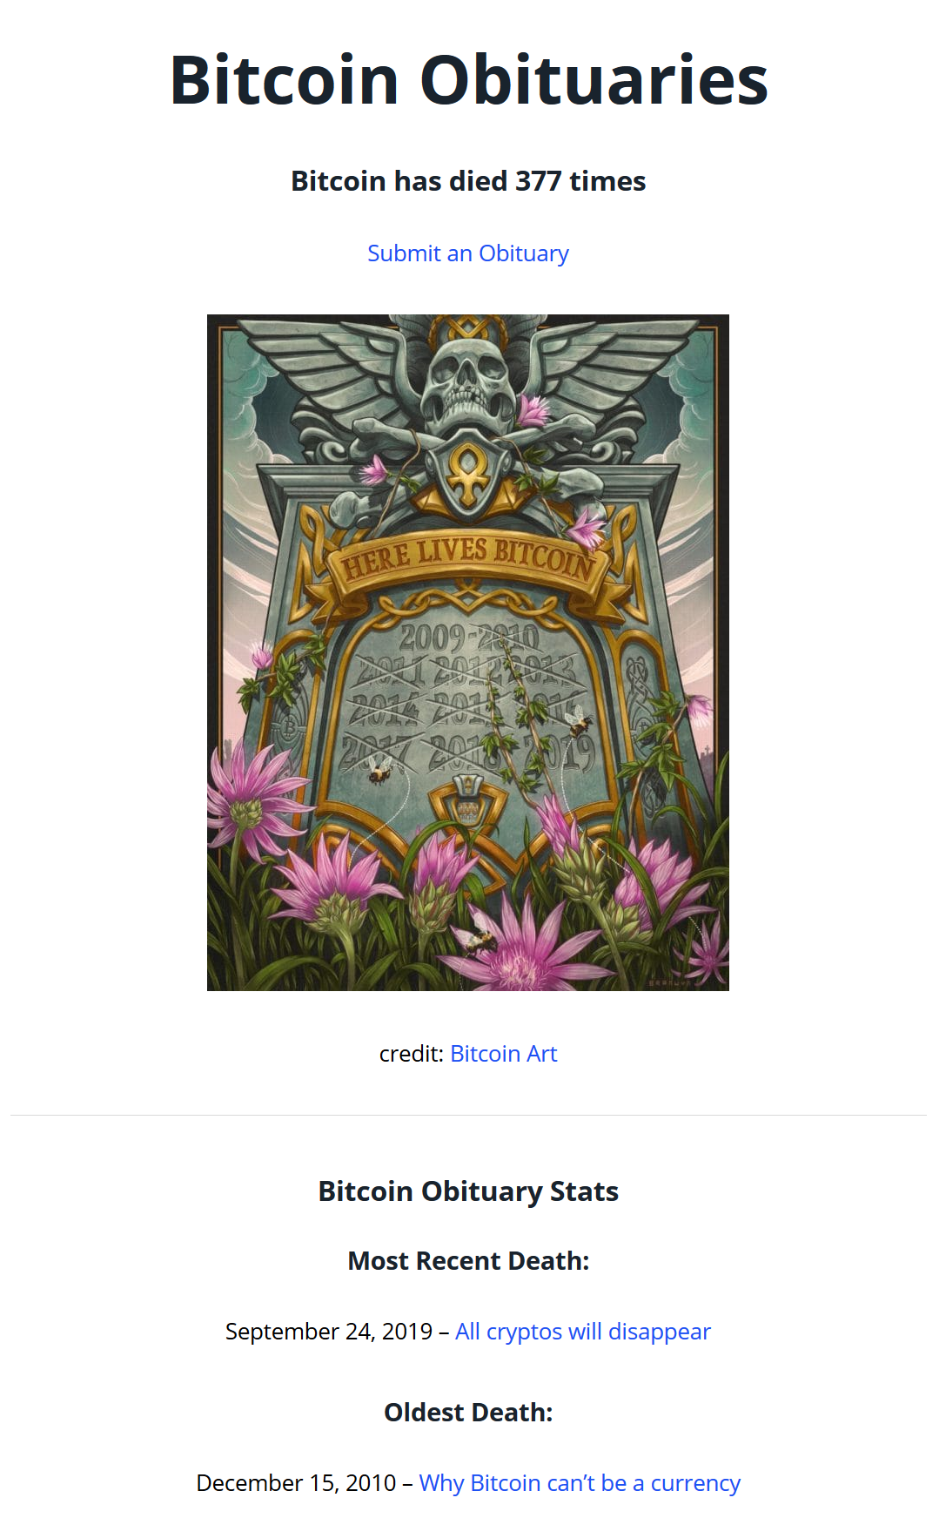
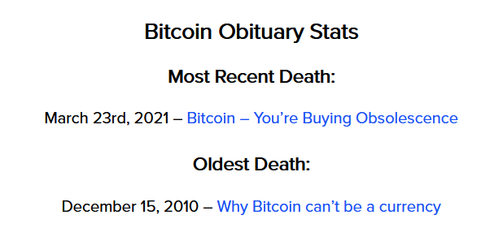
Bitcoin
A bit of fun: Bitcoin Obituaries
405 times
Declared dead over 405 times, and yet… still alive and operating!
https://99bitcoins.com/bitcoin-obituaries/

Slide 37
Summary
Public key cryptography & hashes
Bitcoin, transactions, Script, mining, state

Slide 38
Bitcoin
Source of most materials:
Xiwei Xu, Ingo Weber, and Mark Staples. Architecture for Blockchain Applications. Springer, 2019

